Slide 1

PHARMACY MANAGEMENT SYSTEM
MODERN EDUCATION SOCIETY’S COLLEGE OF ENGINEERING, PUNE-01.
PROJECT BASED LEARNING 2022-23.
SUBMITTED BY : GUIDED BY :
Kalpesh Baviskar Mrs. Sayali Sapkal
Ashish Shisal
Saurabh Butale
Ayush Acharya
Omkar Latpate

Slide 2
APPENDIX
Problem Statement
Objectives
Introduction
Motivation
Literature Survey
Methodology
Requirements
Challenges Faced
Conclusion
Future Scope
References

Slide 3
PROBLEM STATEMENT
Managing pharmacy records on paper is tedious ,time consuming and difficult task, may lead to inaccurate calculation which can make customer dissatisfied .
This project will help pharmacist to use time efficiently and maintain records of inventory accurately.
OBJECTIVES
Streamlining inventory management.
Enhancing prescription processing.
Improving patient record-keeping.
Improving efficiency and accuracy of store.

Slide 4
INTRODUCTION
Most Pharmacies are still doing their whole work manually, this kind of work may lead to mistake by workers and lead to a major problems.
Therefore to solve this kind of problems the urgent need is to develop a Pharmacy management system that will prove beneficial for the Pharmacy.
Our Pharmacy Management System aims to maintain inventory, incoming and outgoing of more smoothly and in a better way.

Slide 5
MOTIVATION
When we visit Pharmacy store we see following issues faced by pharmacist and customers
Time efficiency
Ambiguity about availability of medicine.
Maintaining large scale of data manually.
So in a medical store doing manual work, having a huge queue of customers can lead to above mentioned issues. So by implementing a medical management system can help build an efficient Pharmacy store and can lead to customer satisfaction.

Slide 6
LITERARTURE REVIEW
Sr. No. | Research Paper Name | Proposed Methodology | Limitations
1. | Pharmacy Management System : A Review (2022) | Makes use of DBMS This data is also important for users of store systems such as Gilead Pharmacy in reducing medical errors and speculation caused by a lack of quick information about pharmacy continuity | Not provided any technical details. Not provided any potential drawback.
2. | Efficient Medical Management System for Pharmacist (2021) | To design maintenance software, we required Python, a powerful cross-platform language, any device with a Windows or GNU/Linux Interface, application and the dynamic content will be fulfilled by SQL. | The paper only focuses on the perspective of pharmacist.
3 | Survey On Pharmacy Management System (2021) | Record of patient and there transaction should be stored in organized manner . Pharmacists maintain there sales record and other record and keeps them updated in real time with the current stock of medicines they have with security of previous data getting stored in SQL database. | Not compared the existing pharmacy management systems to determine it’s relative strengths and weaknesses.

Slide 7
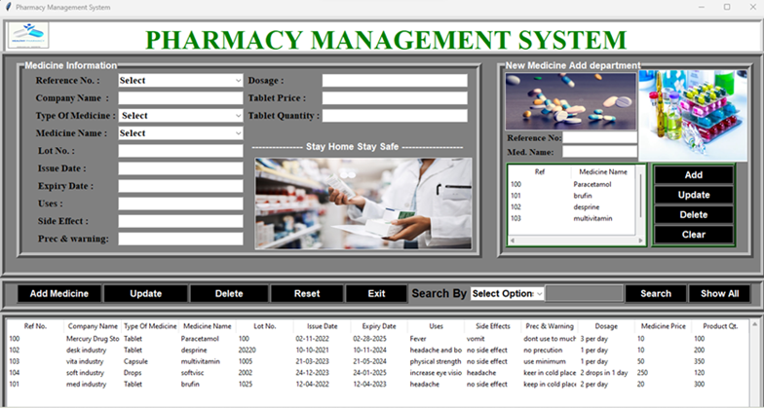
PROPOSED METHODOLOGY
We have created a pharmacy management using PYTHON programming language.
We have created following modules for our system :
Add New Medicine :- Adding new entry for medicine.
Update :- Updating available medicine according.
Display whole slot :- Displaying all medicine information available in system.
Delete :- Deleting old and used information from system.
Search :- Searching needed medicine.
Maintain Database :- Maintaining Database easily.
We have used various libraries like Tkinter , PIL ,
SQLite3 for various function like GUI interface and
Database file management

Slide 8
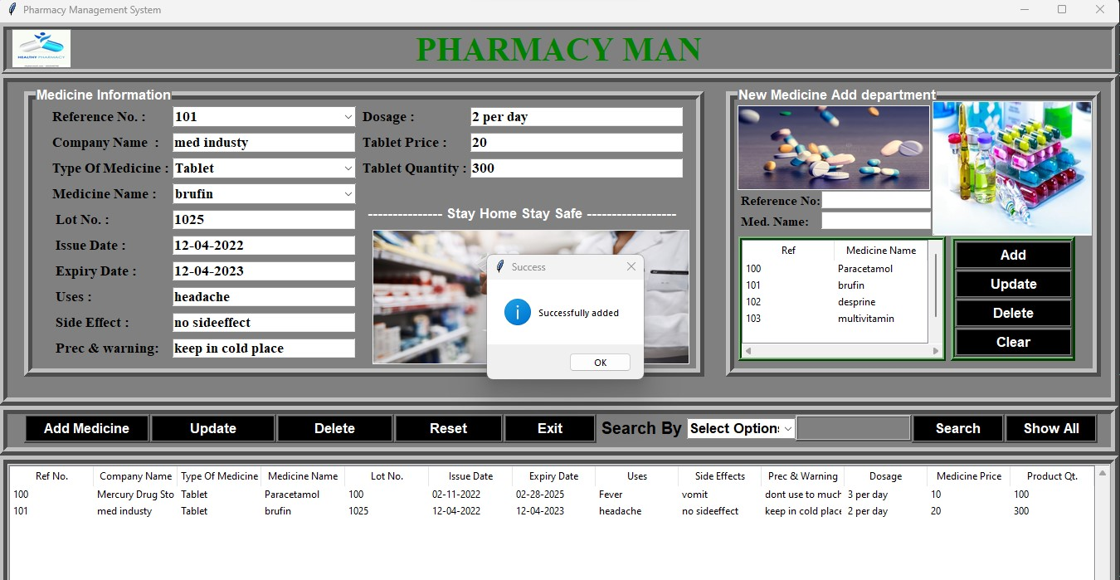
IMPLEMENTATION RESULT

Slide 9
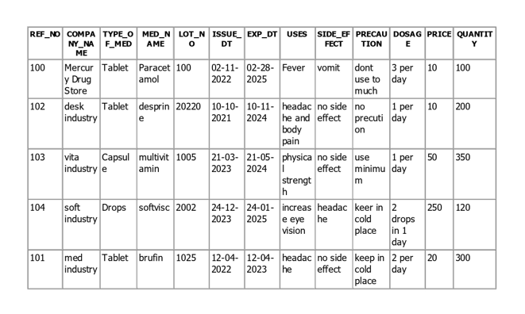
SYSTEM DATABASE FILE

Slide 10
REQUIREMENTS
Software Requirements
Hardware Requirements
Frontend : Python
Backend : SQL Lite3
IDE : Visual Studio, PyCharm
Operating System : 64 bit OS Windows, MAC OS, Ubuntu
Libraries :
Tkinter
PIL
Random
Processor : 11th Gen Intel® Core™ i3
RAM : 8 GB
Main Memory : 2GB
Peripherals : Color Monitor, Keyboard, Mouse

Slide 11
CHALLENGES FACED
Installing different inbuilt Python Packages.
Creating a database file and importing in a program.
Solving runtime errors.
Finding the system bugs and fixing them.

Slide 12
CONCLUSION
The effective implementation of this software will manage all the needs of pharmacy.
It is capable of providing easy and effective storage of information related to activities happening in the Medical Store.
Due to automation the pharmacist does his or her work much faster.

Slide 13
FUTURE SCOPE
This system helps pharmacists to improve supply, cost, management and sales from the inventory.
But, the parts that can be further developed are, creation of a login page for the owner, maintaining the record of the suppliers, creating appointment facility for doctor system.
This system can also be made to develop a management system for shopkeepers.

Slide 14
REFRENCES
Python for Desktop Applications: How to develop, pack and deliver Python applications with Tkinter by Tran Duc Loi.
Python in a Nutshell: A Desktop Quick Reference, Third Edition by Alex Martelli, Anna Ravenscroft, Steve Hoiden.
https://aipublications.com/uploads/issue_files/7IJEEC-JUN20218-Pharmacy.pdf
https://www.irjmets.com/uploadedfiles/paper/volume_3/issue_12_december_2021/18007/final/fin_irjmets1641021488.pdf
W. J. Bicket, J. P. Gagnon. (1981). Purchase and inventory control for hospital pharmacies. Topics in hospital pharmacy management / Aspen Systems Corporation
https://ijesc.org/upload/4c640fa99bfccdcf6f90430972e263e6.Pharmacy%20Management%20System%20A%20Review.pdf

Slide 15
Thank You!!!
Prepared By :
Group No. 7

